Slide 1

analytics project: potential factors on US cancer rates

Slide 2

AGENDA
Team Members
Hypothesis
Methodology and Data
Analytics and Analysis
Conclusion

Slide 3

Team Members
Abel Dumecha
Adam Gilmore
Cassidy Schultheis
Jessica Snowden
Mina Agyna

Slide 4

Hypothesis
Cancer rates are increasing--both for the number of incidents as well as the mortality rates.
Americans are getting cancer at younger rates each year.
Physical location impacts cancer rates and types of cancer
Age impacts cancer rates and types of cancer
Gender impacts cancer rates and types of cancer
Race impacts cancer rates and types of cancer

Slide 5
DATA Selection
Centers for Disease Control’s US Cancer Statistics (1999 - 2020)
https://www.cdc.gov/cancer/uscs/dataviz/download_data.htm
Variables Selected
Age
Count (number of individuals with cancer)
Event Type (i.e. Instance or Mortality)
Population of reporting area (i.e. State)
Race
Rate
Sex
Site (i.e. Type of Cancer)
Year

Slide 6
Cancer rates are increasing— both for the number of incidents as well as the mortality rates.
Hypothesis 1

Slide 7
Hypothesis Cancer rates are increasing--both for the number of incidents as well as the mortality rates.
Null-Hypothesis
Cancer rates are not changing year over year.
Alternative Hypothesis
Cancer rates are changing year over year.

Slide 8
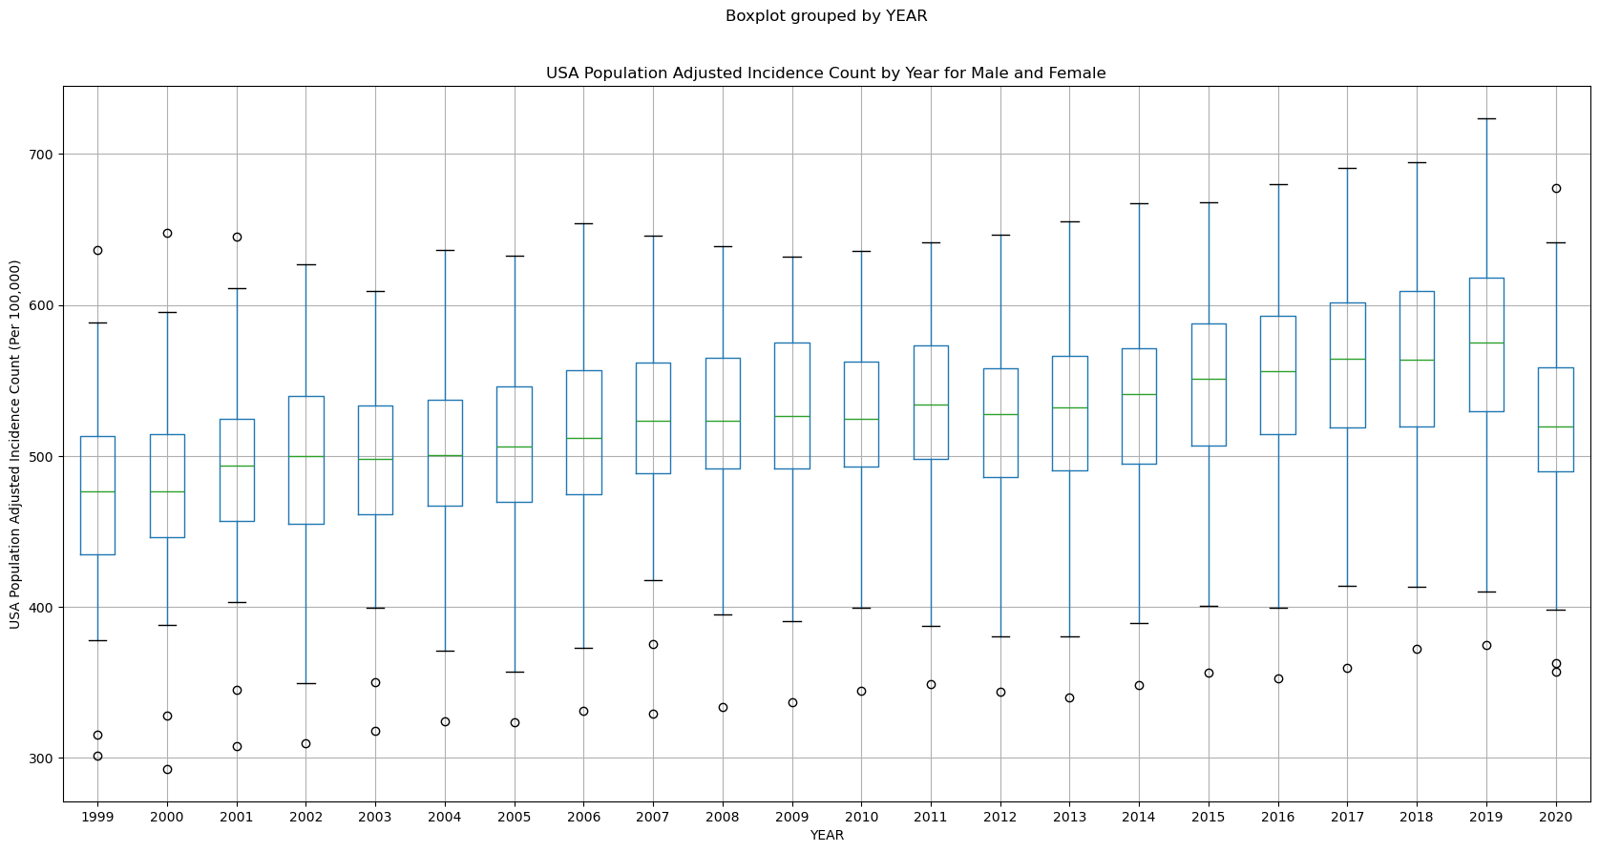
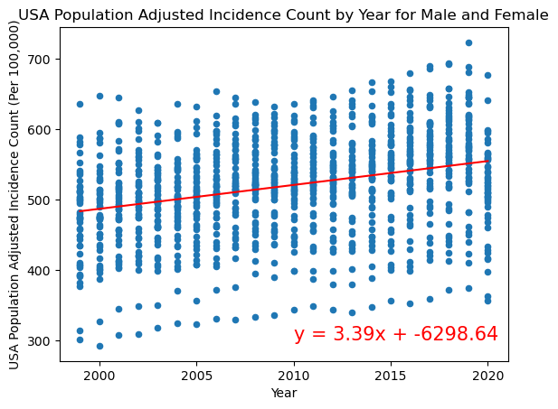
Cancer rates are increasing
Visualization: USA Population Adjusted Incidence Count (Per 100,000) by Year for Females and Males
Includes all races, ages, and states
Observations:
Incidence rates are slightly increasing year over year
This may be be to new detection methods and technologies
Drop in 2020 due to COVID
The correlation between year and incidence count is 0.31 indicating a very weak positive correlation

Slide 9
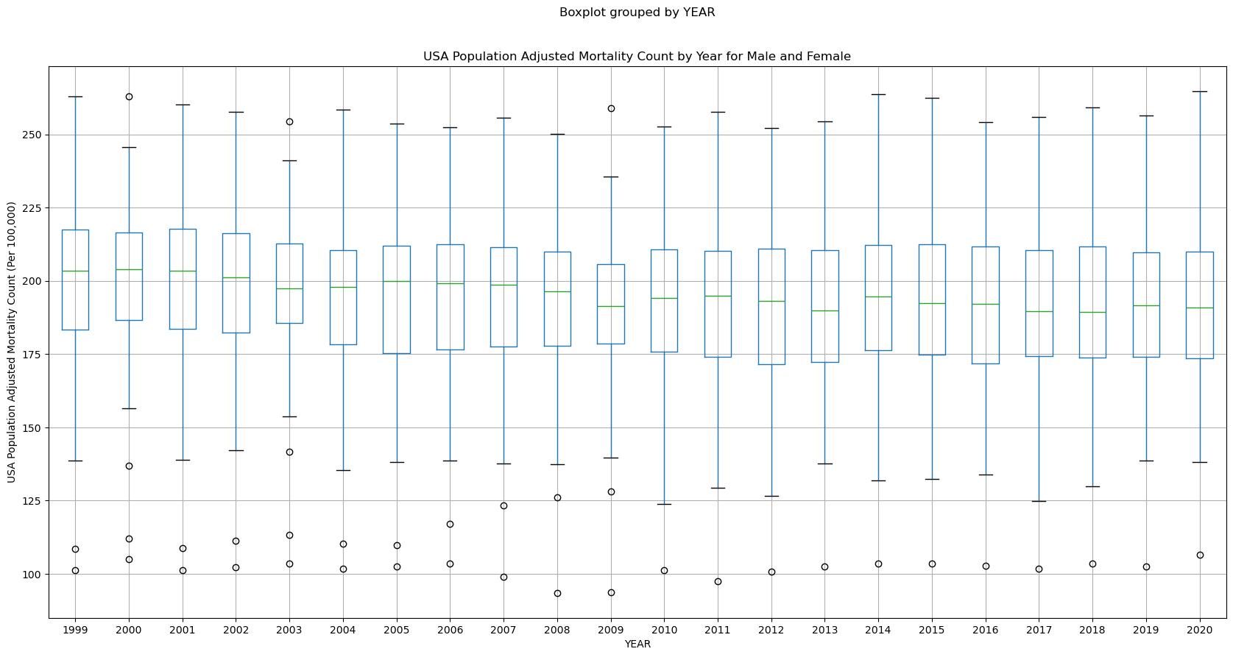
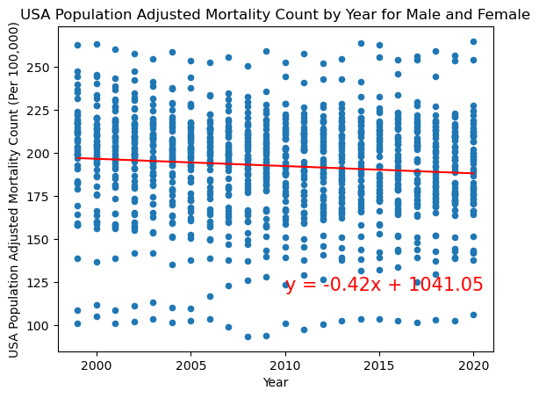
Cancer rates are increasing
Visualization: USA Population Adjusted Incidence Count (Per 100,000) by Year for Females and Males
Includes all races, ages, and states
Observations:
Mortality rates are slightly decreasing
The correlation between year and incidence count is 0.09 including either no correlation or an extremely weak negative correlation
This may be due to new research treatments available

Slide 10
Cancer rates are increasing
--INSERT STATISTICAL TEST--
P-Value
What was the p-Value
What does the p-Value mean for your data?
Statistical Test
What test did you use?
What does the test mean for your data?

Slide 11
hypothesis is True
Hypothesis 1 - Conclusion
Cancer rates slightly increasing while mortality rates have no change or are slightly decreasing based on both box plots, scatter plots with regression lines and correlation coefficients

Slide 12
Gender does not have an impact on cancer rates and type?
Hypothesis 2

Slide 13
Hypothesis Gender does have an affect on cancer rates-both for the number of incidents as well as the mortality rates.
Null-Hypothesis
Gender does not have an affect on cancer rates.
Alternative Hypothesis
Gender does have an affect on cancer rates.

Slide 14
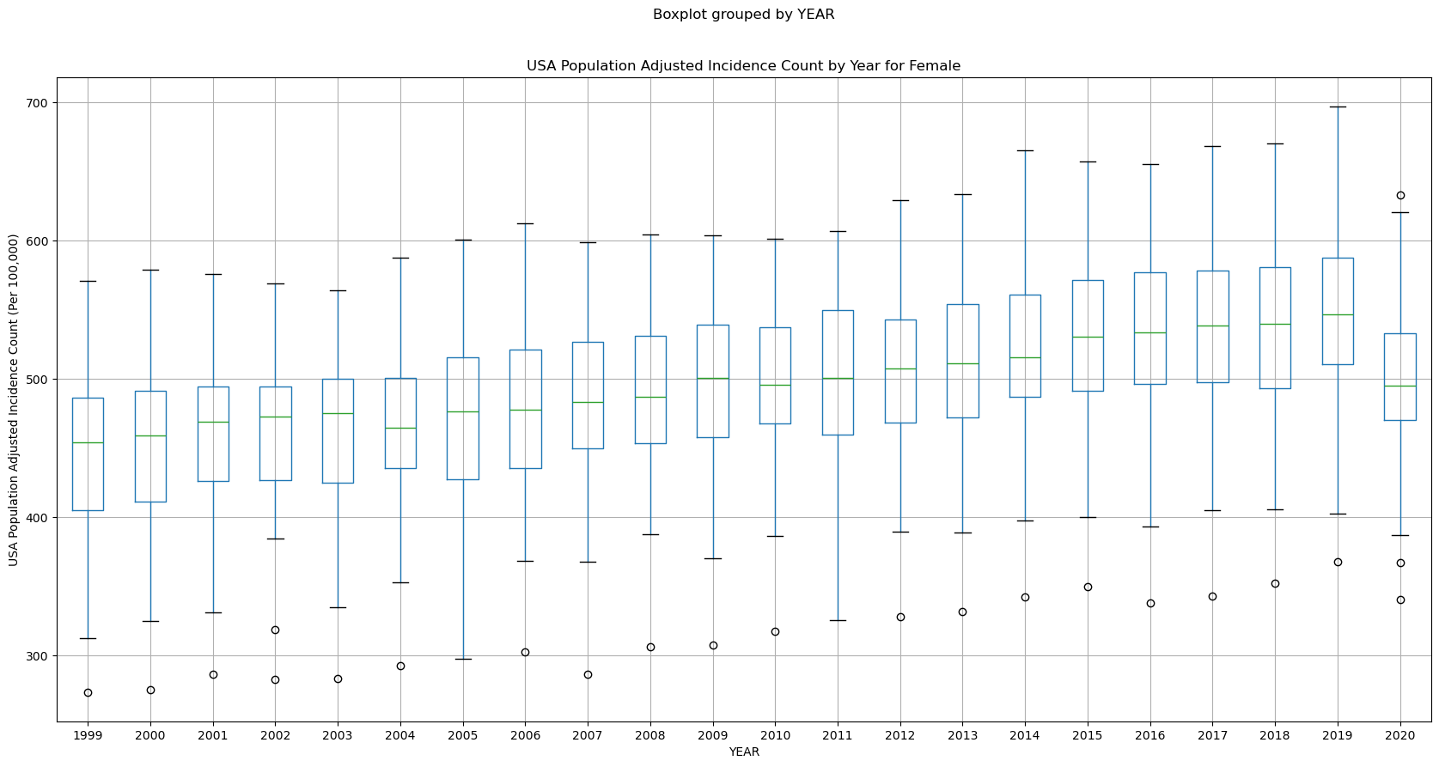
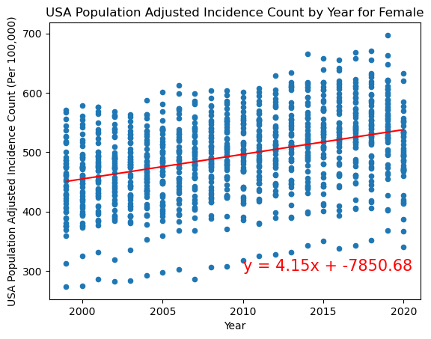
Cancer gender impact
Visualization: USA Population Adjusted Incidence Count (Per 100,000) by Year for Females
Includes all races, ages, and states
Observations:
Incidence rates are slightly increasing year over year for females
The correlation between year and incidence count is 0.39 indicating a weak positive correlatio

Slide 15
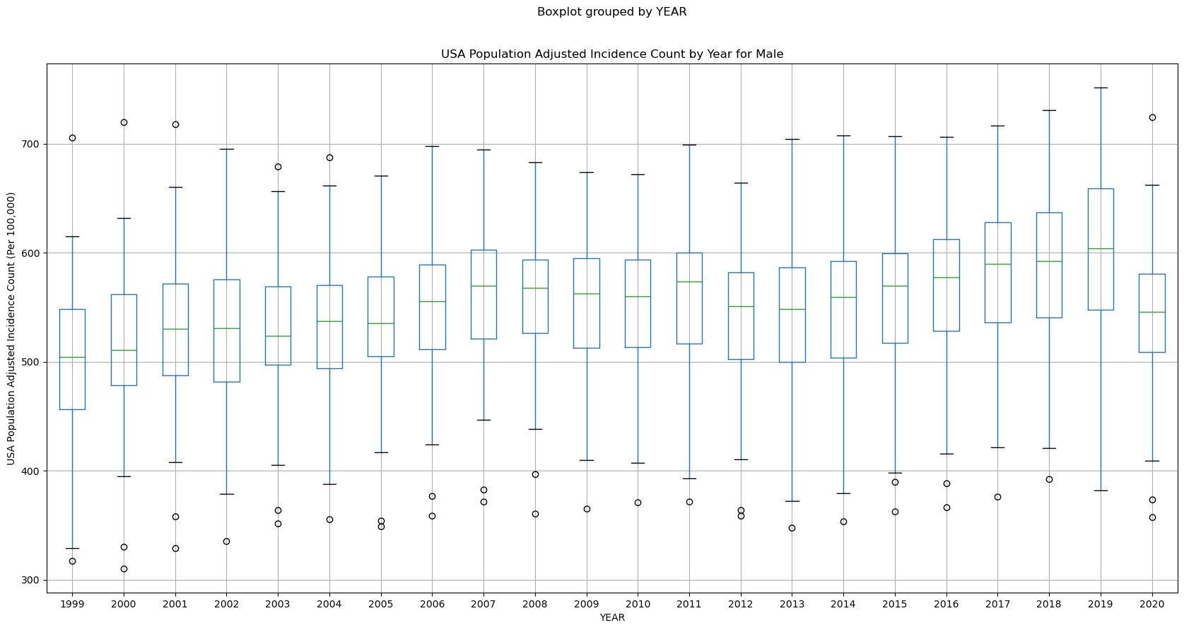
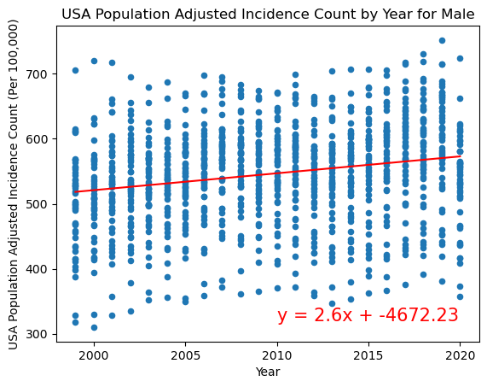
Cancer gender impact
Visualization: USA Population Adjusted Incidence Count (Per 100,000) by Year for Males
Includes all races, ages, and states
Observations:
Incidence rates are slightly increasing year over year for males
The correlation between year and incidence count is 0.22 indicating a very weak positive correlation

Slide 16
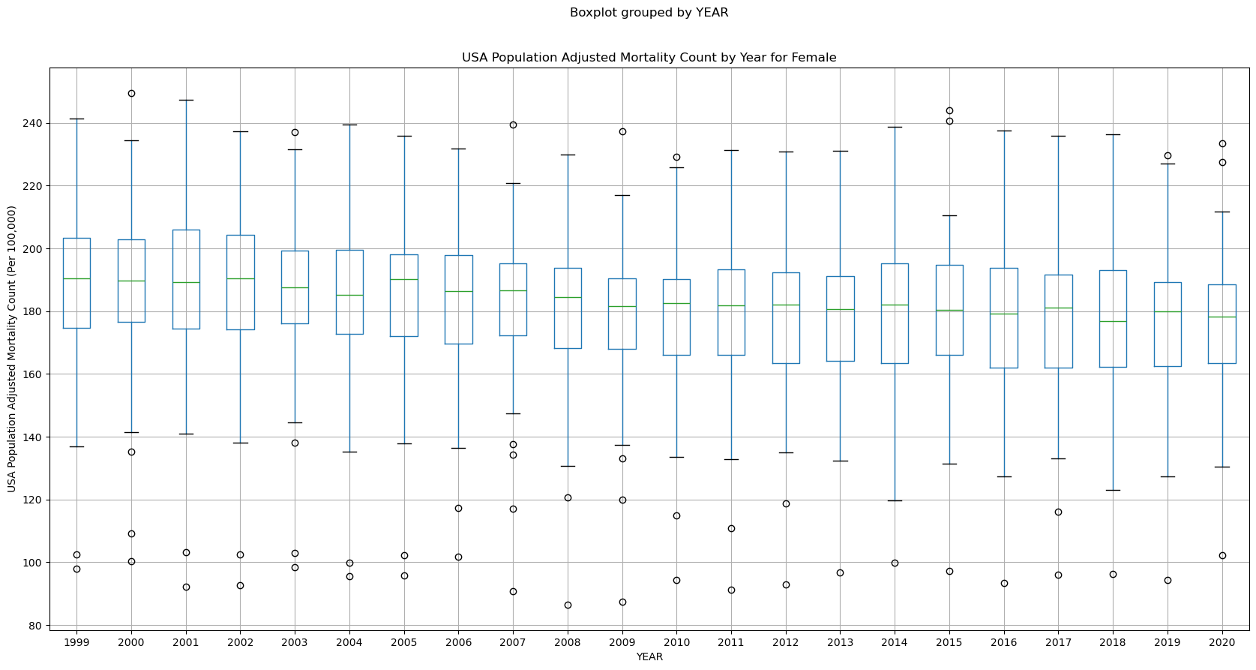
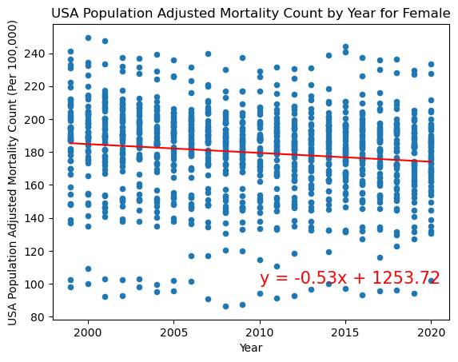
Cancer gender impact
Visualization: USA Population Adjusted Mortality Count (Per 100,000) by Year for Females
Includes all races, ages, and states
Observations:
Mortality rates are slightly increasing year over year for females
The correlation between year and incidence count is 0.13 indicating a very weak negative correlation

Slide 17
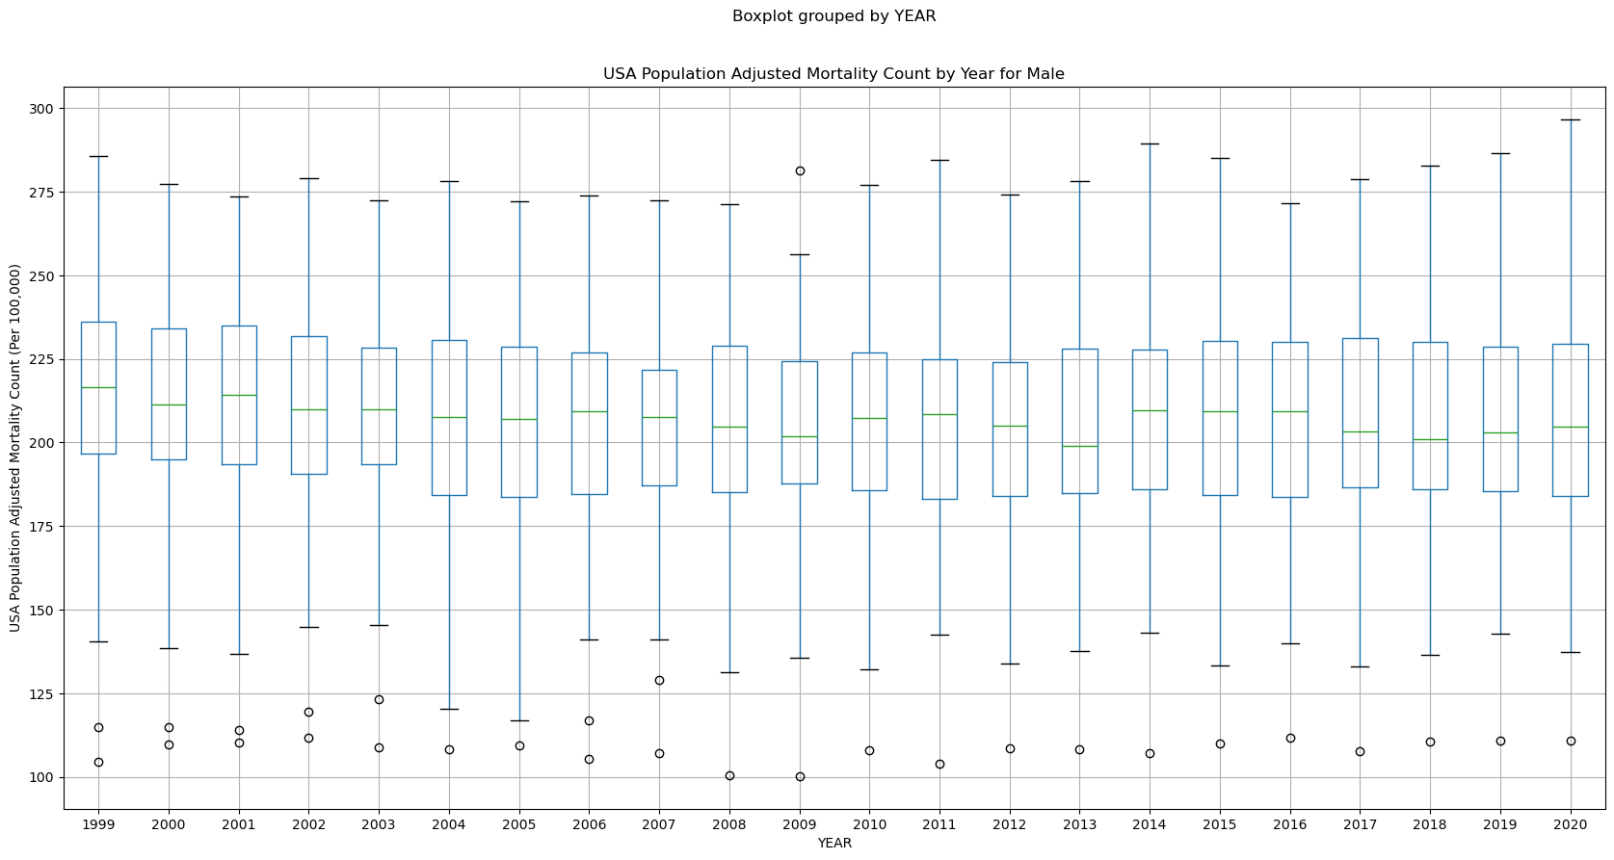
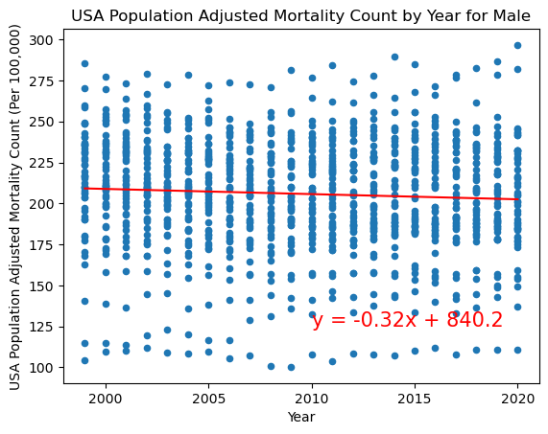
Cancer gender impact
Visualization: USA Population Adjusted Mortality Count (Per 100,000) by Year for Males
Includes all races, ages, and states
Observations:
Incidence rates are slightly increasing year over year for females
The correlation between year and incidence count is 0.22 indicating a very weak correlation

Slide 18
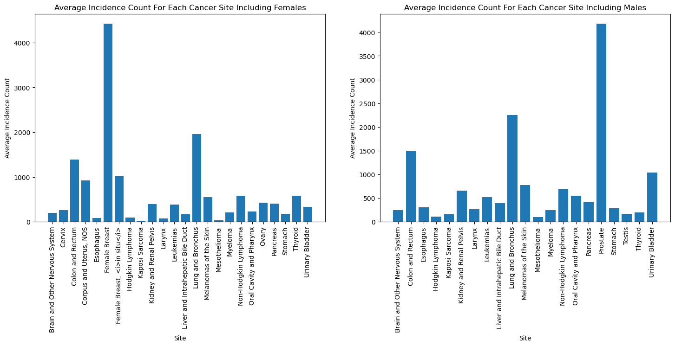
Cancer gender impact
Visualization: Average Incident Count for Each Cancer Site Include Males and Females
Includes all races, ages, and states
Observations:
pvalue=0.7350786754499713

Slide 19
Cancer gender impact
Visualization: Average Mortality Count for Each Cancer Site Include Males and Females
Includes all races, ages, and states
Observations:
pvalue=0.6787523866184775

Slide 20
hypothesis is <TRUE/FALSE/Inconclusive
Hypothesis 2 - Conclusion
Gender <are/are not/are incluclusive> increasing— both for the number of incidents as well as the mortality rates Based on (insert response here… based on graphs, p-values, etc.)

Slide 24

Questions?

